Slide 1
signum
FRAMEWORK
Olmo del Corral
olmo@signumsoftware.com

Slide 2
Signum Framework
Complete Solution 25+ reusable modules
High Productivity Using the latest technologies
Simple Business Logic Technical Abstraction
Interchangeable Developers Homogenous Architecture

Slide 3
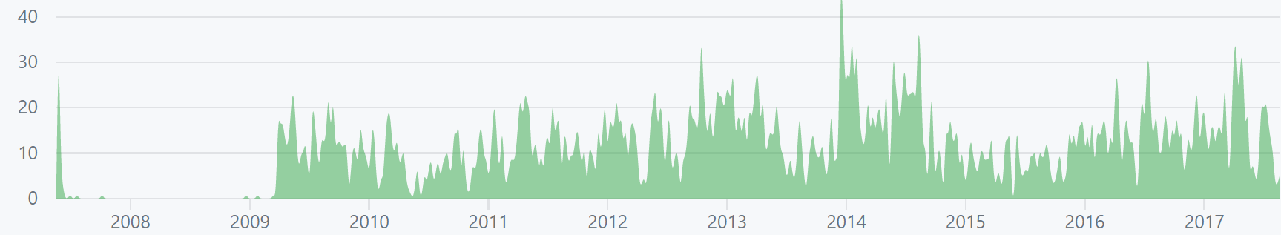
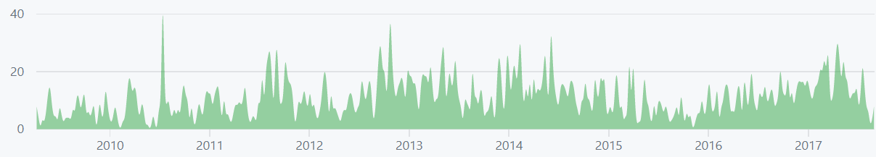
History
SIGNUM FRAMEWORK 5
.Net Framework 4.6
React
Web.API
Typescript No-nullable
React Bootstrap
(Bootstrap 4)
(.Net Core)
SIGNUM FRAMEWORK 4.0
.Net Framework 4.5
ASP.Net MVC 5
TypeScript
Bootstrap
Symbols
Mixins
UnsafeInsert
UnsafeUpdate
SIGNUM FRAMEWORK 2.0
.Net Framework 4.0
ASP.Net MVC 2
Signum.Web
New Windows look
Correlated sub queries
SIGNUM FRAMEWORK 3.0
ASP.Net MVC 3
Operations
UnsafeDelete
Collections in Search Control
SIGNUM FRAMEWORK 1.0
.Net Framework 3.5
ORM with LINQ
WPF
Schema Sync
Previous Engine
ORM
VisualBasic
Previous Framework
XML Screens
Operations
Authorization
Operations
Excel reports
Files
Processes
Scheduler
Auth 2.0
User Queries
User Charts
Dashboards
Mailing
Cache
Profiler
SMS
Disconnected
Charts 2.0
Omnibox
Translation
Isolation
UI Testing
Diffs
Migrations
WordTemplates
Dynamic
Workflow
RestLog
(Predictor)

Slide 4










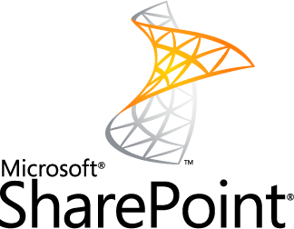







Technical Framework
Application Platform
Flexibility to Move
Complete Control
Fully Featured Custom code is a ‘plugin’
Technical Framework
Complete Solutions
signum
FRAMEWORK

Slide 5
Traditional Architecture
Web application
Single Page application
Client Application
Scripts
View
View
jQuery
React
Telerik
Views
Dispatcher
ViewModel
Bootstrap
Redux
MVVM
Controllers
Controllers
DTO
Services
MVC
Web.API
Data Access Layer / Repositories
Entity Framework
IoC
NLog
Database

Slide 6
Vertical Modules
Authorization
Invoices
Production
View
View
View
Client
Client
Client
Controllers
Controllers
Controllers
Entities
ViewModel
Entities
ViewModel
Entities
ViewModel
Business Logic
Business Logic
Business Logic
Database
Database
Database

Slide 7
Your Application
Signum Business
Contracts
Addresses
Availability
Banks
Costs
Doc.Input
Products
Reports
Clients
Payments
Checkout
….
Price Lists
Taxes
Companies
Invoices
Your Application
AccessControl
Orders
Suppliers
Stock…
Signum Extensions
Your Application
Your Application
Charting
Cache
Profiler
Files
Scheduler
Mailing
SMS
Notes
Disconnected
User Queries
Alerts
Selenium
Dashboard
Excel
Processes
Help
Authoriztion
Isolation
Omnibox
UIAutomation
Your Application
Signum Framework
Signum Windows
Signum Entities & Services
Signum Engine
Signum Utilities
Signum React
System
WPF
Entity Framwork
ASP.Net Web.API
.NET Framework
JSON.Net
Typescript
React
Bootstrap
…
D3.js
web libraries

Slide 8
Entity Framework
Modular ☹
using (var db = new MyDataContext()) { db.Orders.Where(c => c.Customer.Name = "John"); }
using (var db = new MyDataContext()) { db.Customers.Where(c=>c.Name = "John"); }
public class MyDataContext { public DbSet<Order> Orders; public DbSet<Customer> Customers; }
class Order { public EntityRef<Customer> Customer; }
class Customer { public EntitySet<Order> Orders; }

Slide 9
Signum Framework
Modular ☺
Order Module
Customer Module
Database.Query<Order>().Where(c => c.Customer.Name = "John");
Database.Query<Customer>().Where(c=>c.Name = "John");
SchemaBuilder sb = new SchemaBuilder();
sb.Include<Order>();
sb.Include<Customer>();
class Order { public Lite<Customer> Customer; }
class Customer { }
static Expression<Func<Customer, IQueryable<Order>>> OrdersExpression = c => Database.Query<Order>().Where(o => o.Customer == c); public static IQueryable<Order> Orders(this Customer c) { return OrdersExpression.Evaluate(c); }

Slide 10


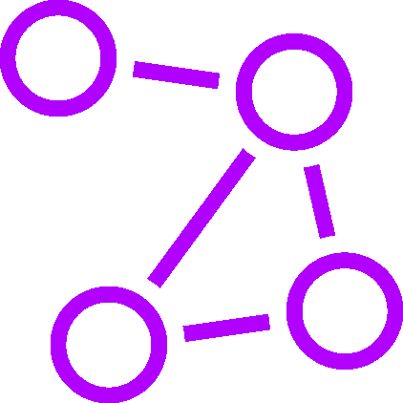
Modular Framework
Database First | Flexible | Code First
LINQ to SQL Ruby on Rails | NHibernate | Django (Python)
<XML>
Entity Framework
Signum Framework

Slide 11
Controlling Dependencies
Don’t Repeat Yourself
Custom Application
Custom Application
Signum Framework
ASP.Net Web.API
Angular
Entity Framework
ASP.Net Web.API
React

Slide 12
Technology Evolution
Visifire
D3.js
Custom CSS
jQuery UI
Bootstrap
4.0 Beta
Javascript
Typescript 0.9
1.0
1.1
1.5
2.0
2.2
2.5
Require.js
WebPack
MS AJAX
jQuery
React.js
ASP.Net
ASP.Net MVC 1
MVC 2
MVC 3
MVC 4
MVC 5
ASP.Net Web API
WebService
Windows Comunication Foundation
WinForms
Windows Presentation Foundation (XAML)
VB/C# 2.0
C# 3.0 (LINQ)
C# 4.0 (dynamic)
C# 5.0 (async)
C# 6.0 (Roslyn)
C# 7.0
Team Foundation Server
GIT
GIT with Submodules
2007
2008
2009
2010
2011
2012
2013
2014
2015
2016
2017

Slide 13
Entities in the middle
Take care… ☹
Windows (XAML)
Web (Razor/C#)
Windows (C#)
Web (TS)
Help (XML)
Logic (C#)
Generated & Synchronized ☺
Compile-time checked ☺
Entities
(C#)
Translation (XML and SQL)
Test Logic/Win/Web (C#)
User Assets (SQL)
Load (C#)
Schema (SQL)

Slide 14
Multilanguage
Translated to:
Fever to translate (just the entities and some messages)
Easier to translate using Sync and Bing

Slide 15
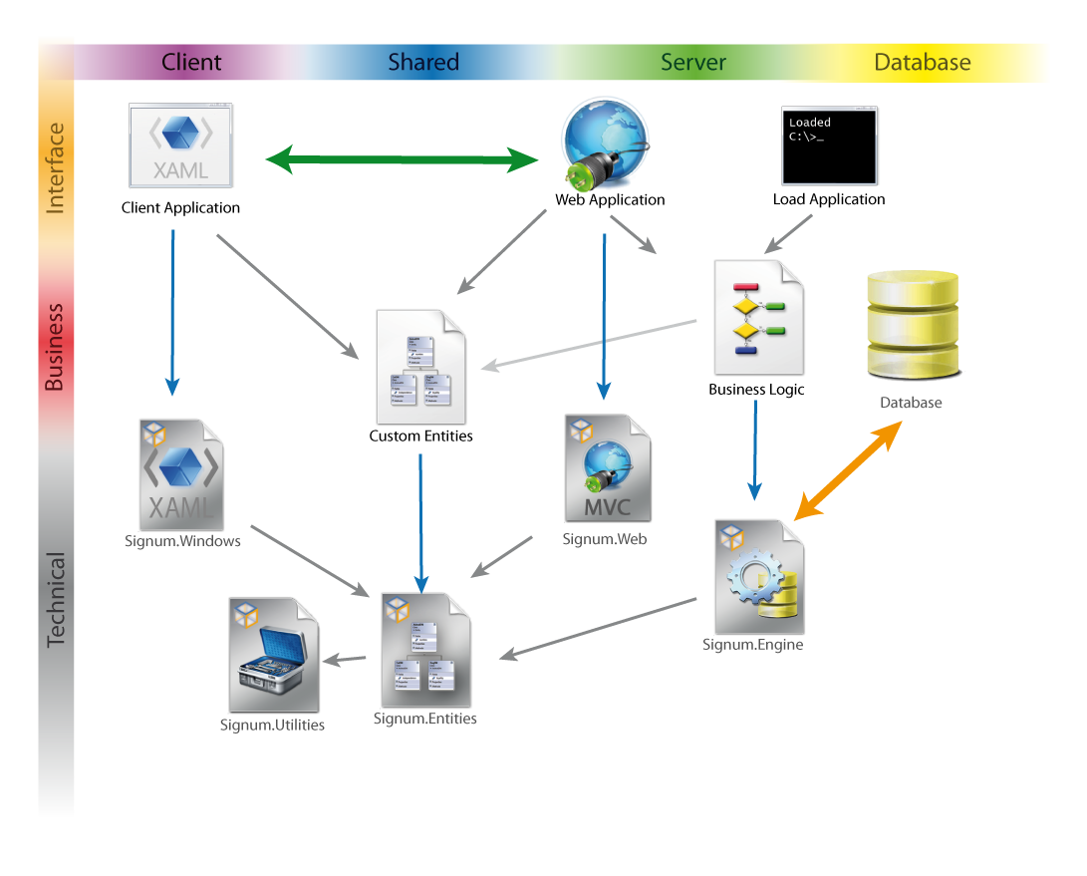
Application Architecture
Signum.Windows
Navigator
Entity controls
Validation
Autocomplete
Search Control
Signum.Web
Navigator
Entity controls
Validation
Autocomplete
Search Control
Signum.Engine
ORM
LINQ
Schema Sync
Transactions
Operations
Signum.Utilities
Extension methods
Strongly-typed Reflection
Directed Graphs
Localization
CSV
Signum.Entities
Base Entities & Attributes
Validation
Serializable
Concurrency
State machines

Slide 16
signumsoftware.com
1. Signum Framework
3. Documentation
https://github.com/signumsoftware/framework
http://www.signumsoftware.com/Documentation
2. Signum Extensions
4. Create Application
https://github.com/signumsoftware/extensions
http://www.signumsoftware.com/en/DuplicateApplication

Slide 17
signum
FRAMEWORK
Olmo del Corral
olmo@signumsoftware.com

